Slide 1
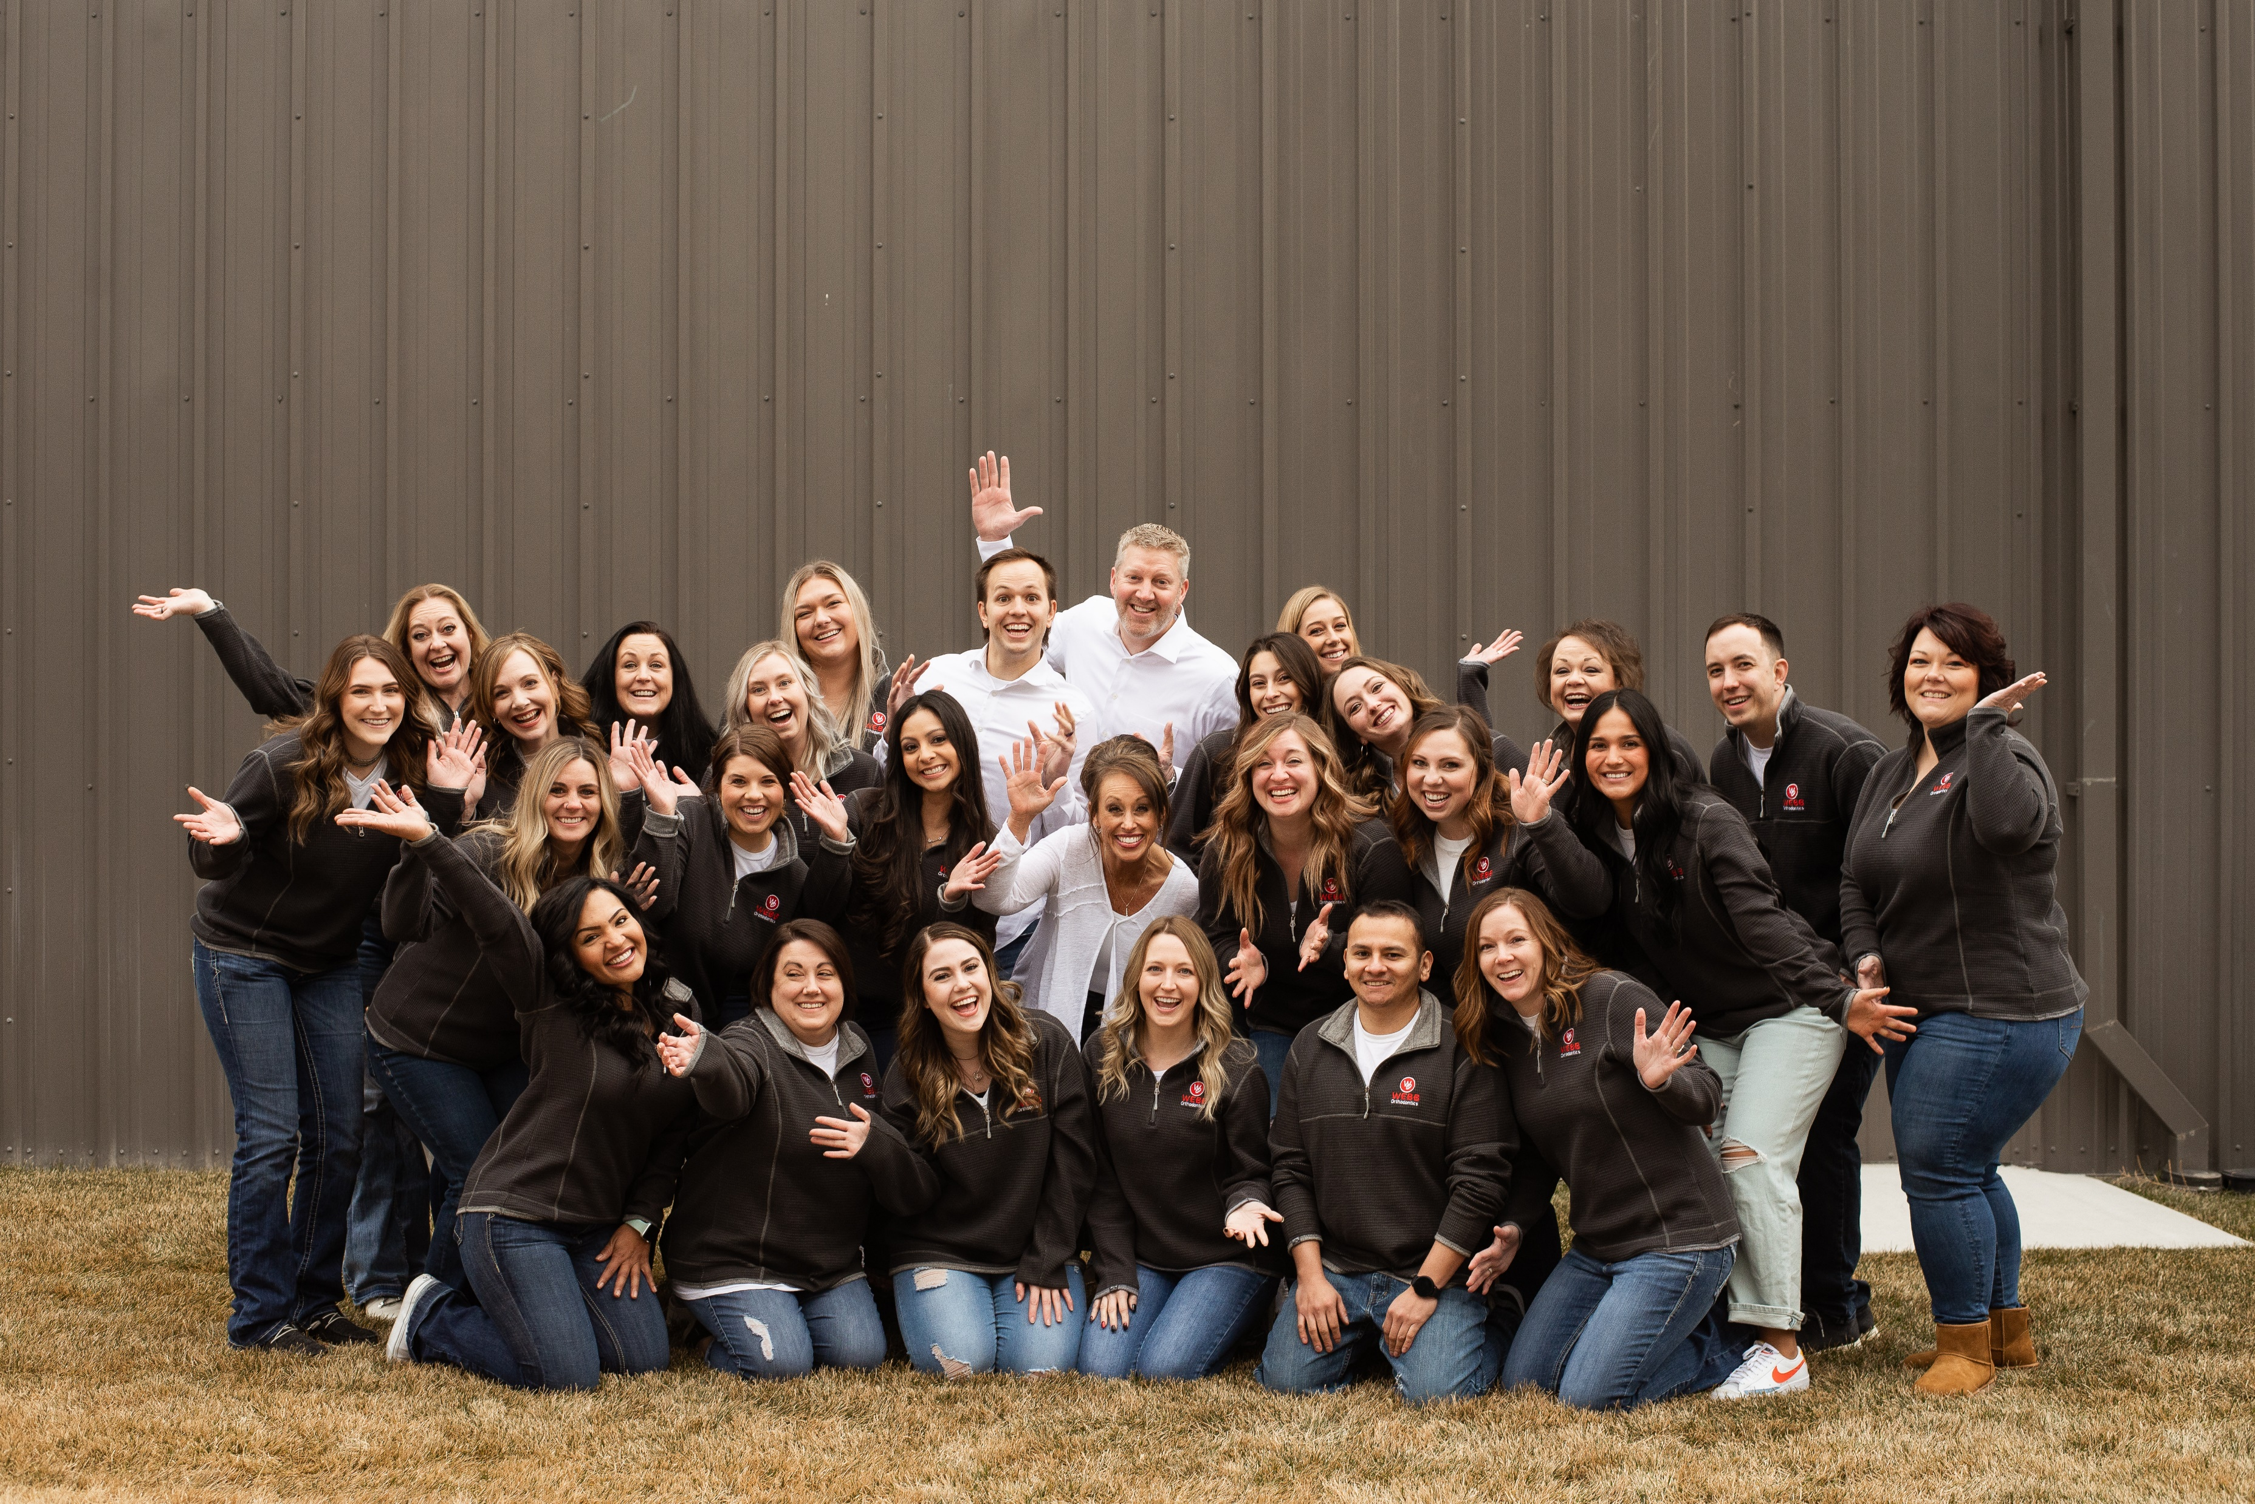
Welcome to Our WEBB ORTHO TEAM!!
Follow these instructions to have an AMAZING SMILE!

Slide 2
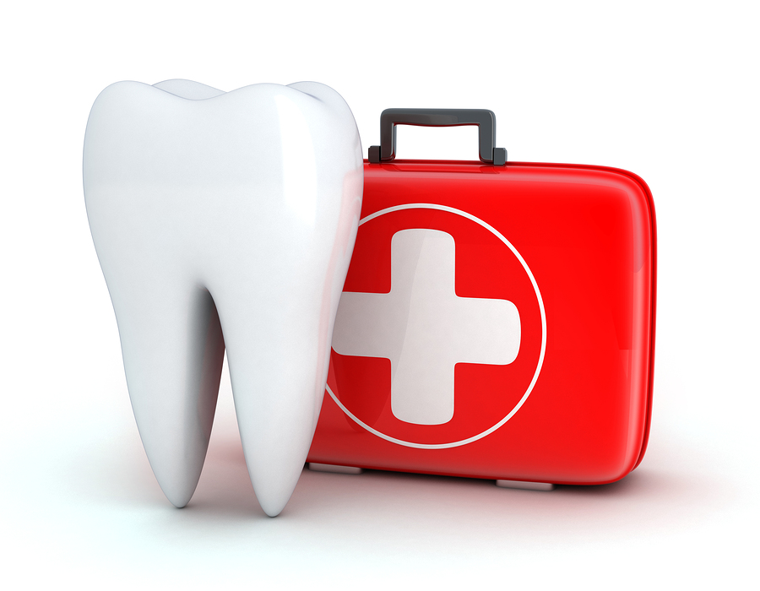
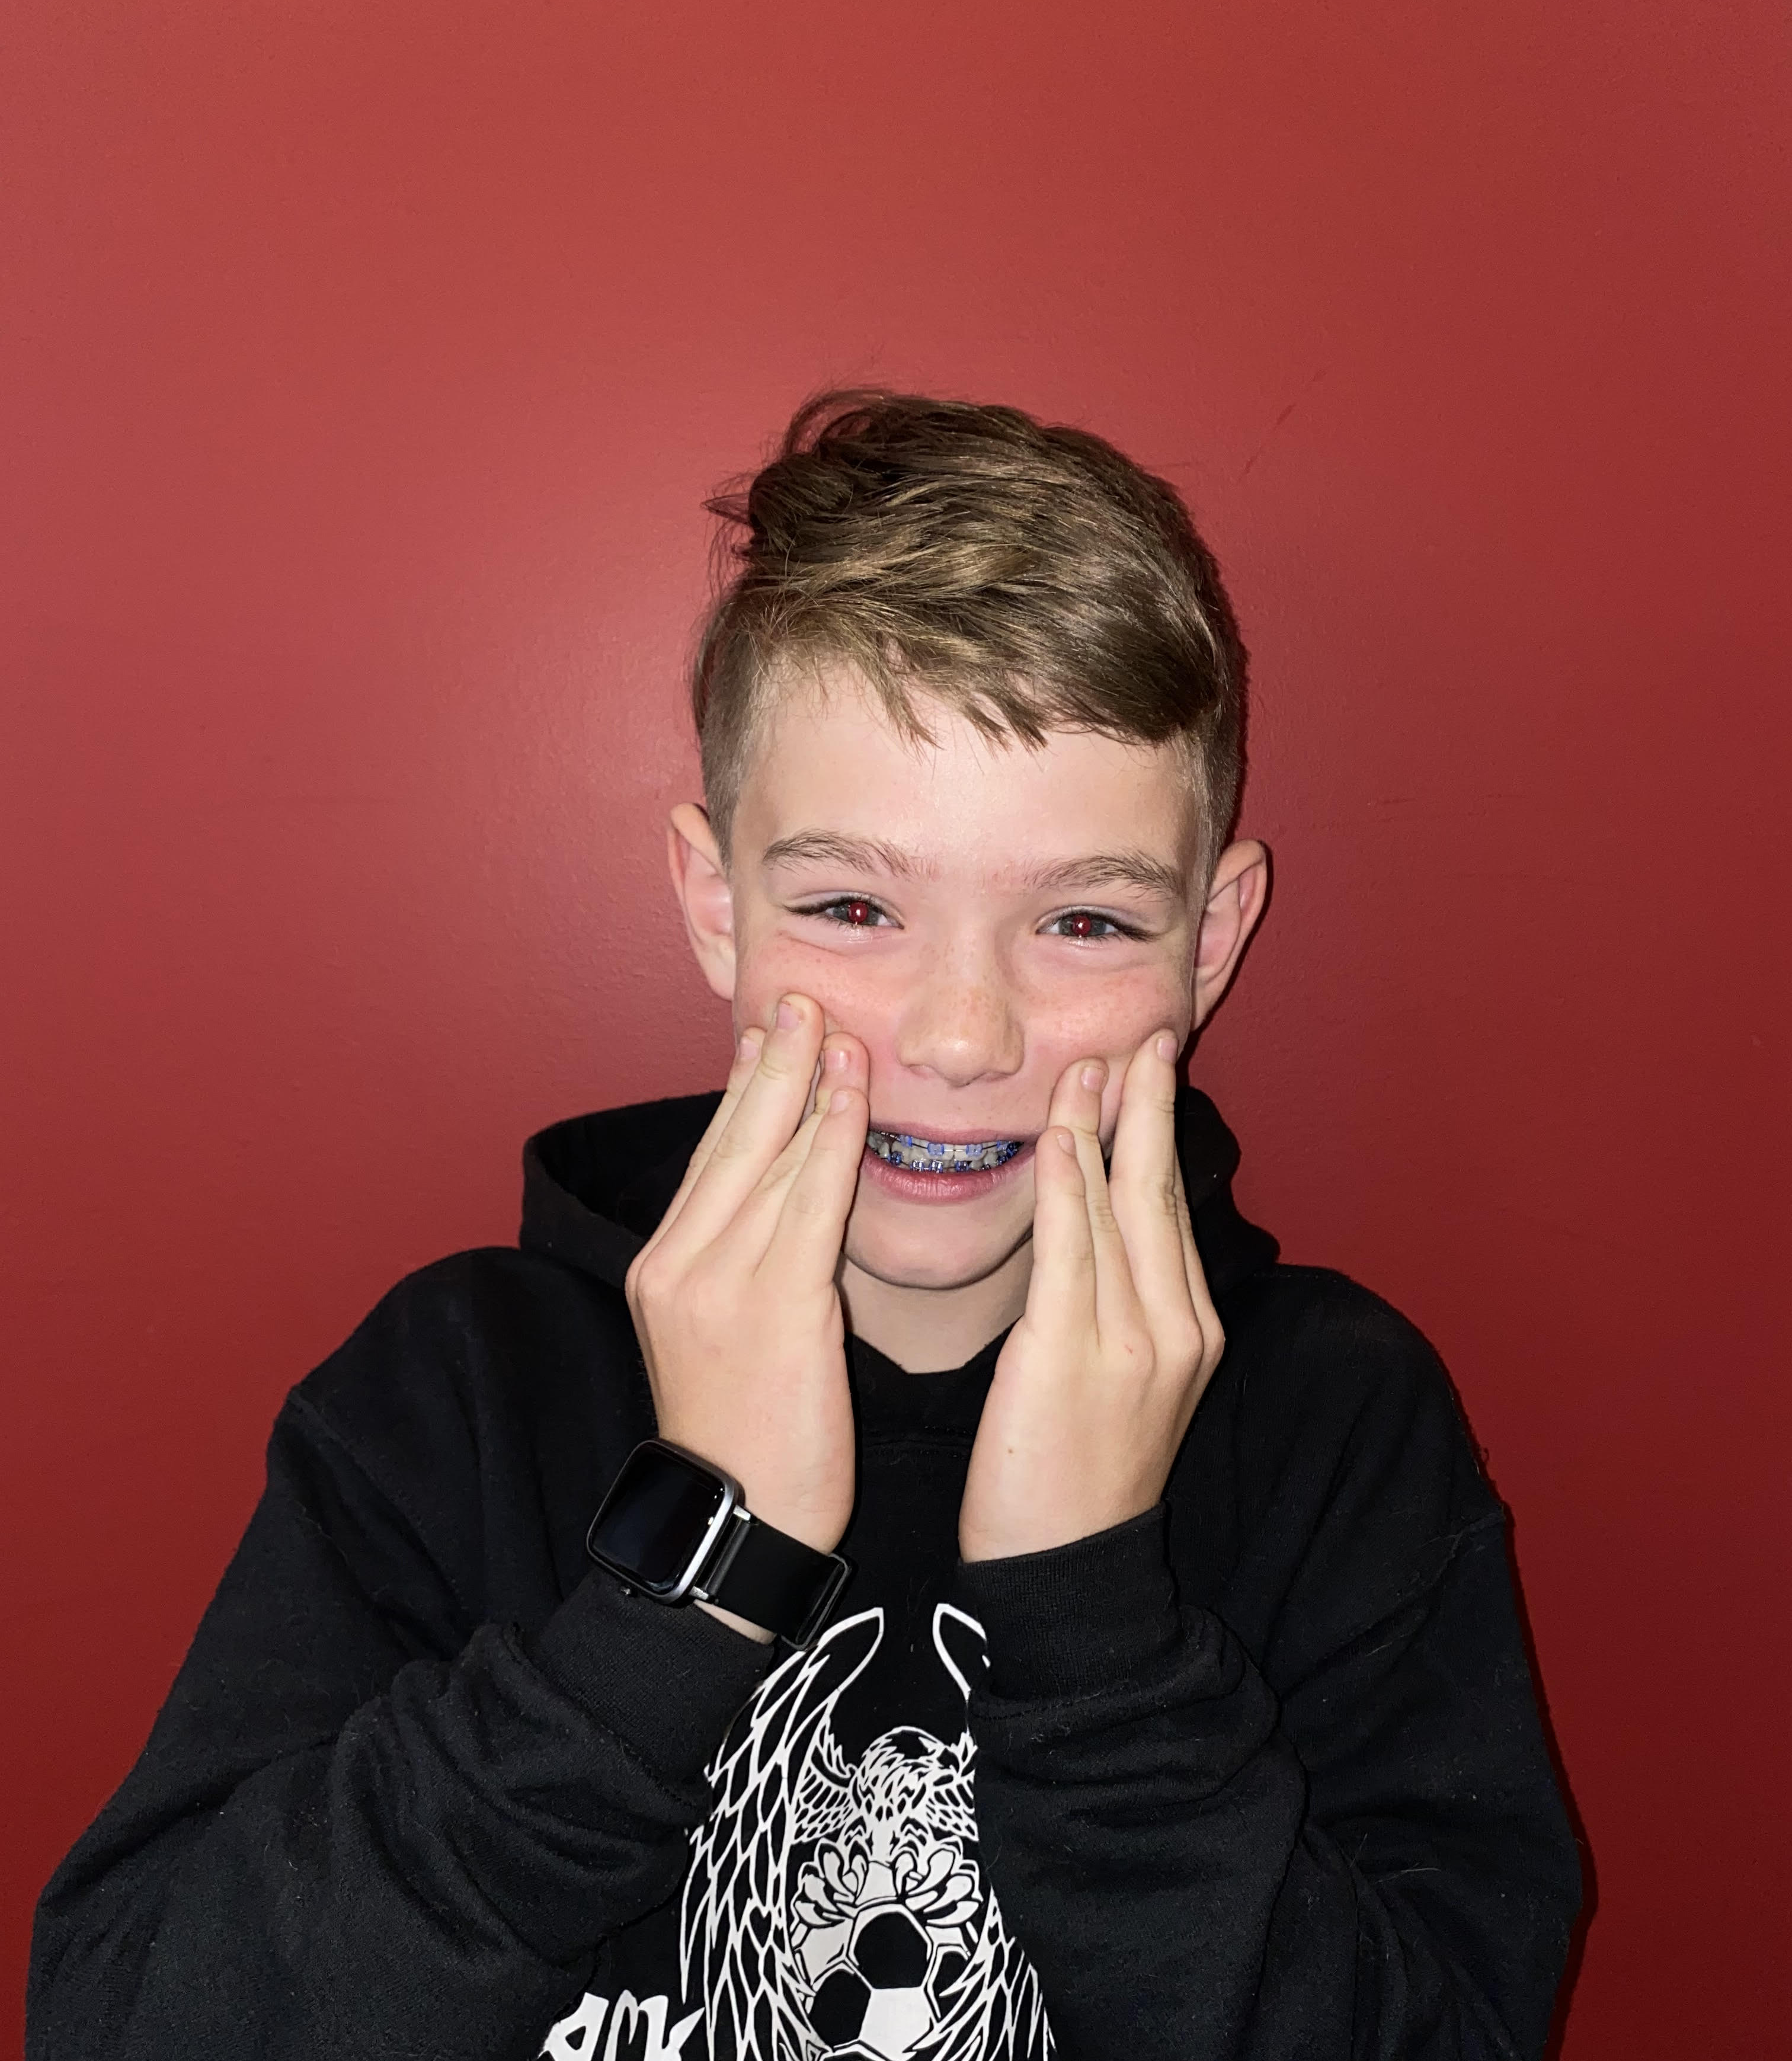
What to Expect the First Few Days
Tooth soreness is normal and will get better within a few days
Warm saltwater rinse will help with irritated gums.
Continue Advil/Tylenol as needed over the first few days.
At the beginning, soft foods will be your best friend. Ice cream, mashed potatoes, applesauce, yogurt and soup.

Slide 3
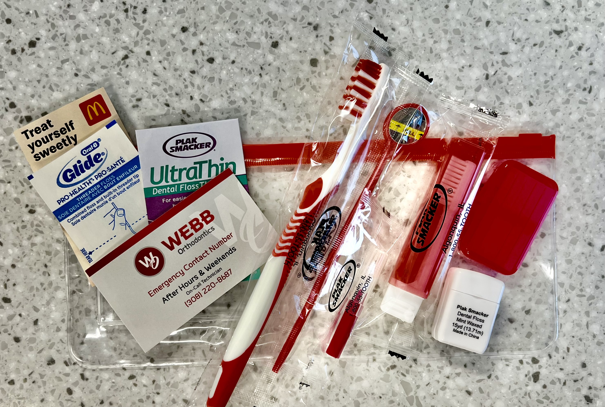
Your Kit Contains
Toothbrush
Glide Threader Floss
Wax
IP Brush
Mouth Mirror
On call emergency contact card
Treat Card ☺

Slide 4
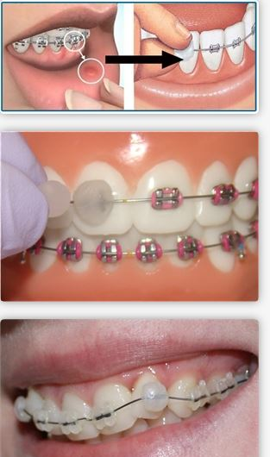
How to Use Wax
Dry the surface off that is causing irritation.
Tear a piece of wax off and soften it between your fingers.
Place wax directly on the bracket that is causing irritation.
Remove wax before eating or drinking and it is not reusable.

Slide 5
How to Use Your IP Brush
Go under the wire with the brush to push food out.
Rinse brush with soap and water after each use.

Slide 6
How to Floss with Braces
Place stiffer end of floss under the wire
Pull floss between teeth like you normally do & repeat
Floss at least 2 times per week
SEE VIDEO

Slide 7
How to Brush With Braces
Brush ALL surfaces in a circular motion.
Make sure to brush teeth, gums, & braces. Do this by using the correct angles.
BRUSH IN THE MORNING, AFTERNOON, AND NIGHT.
SEE VIDEO

Slide 8
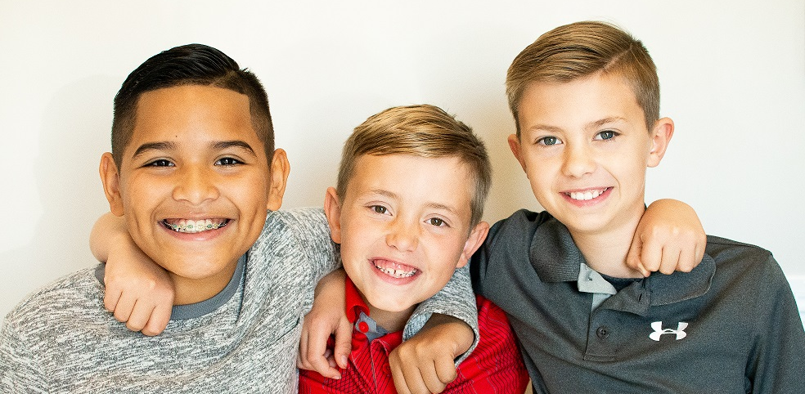
Rule of 3 When Brushing!
Brush 3 times per day
For 3 minutes
At 3 different angles

Slide 9
3 strike policy
Strike 1- If brushing is not good, we will show you and your parents the areas you’re missing. We will send a letter home.
Strike 2- We will prescribe a fluoride toothpaste called Prevident 5000 & inform your dentist.
Strike 3- We will discuss terminating treatment to prevent further damage.

Slide 10
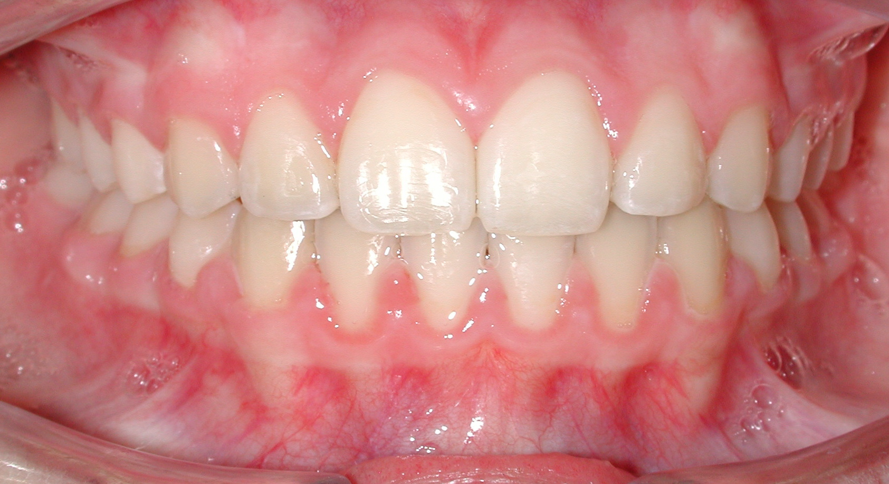
Decalcification
Good brushing ☺
Decal is preventable. All you need to do is brush good & follow the Do’s & Don’ts on the next slide
Bad Brushing ☹

Slide 11
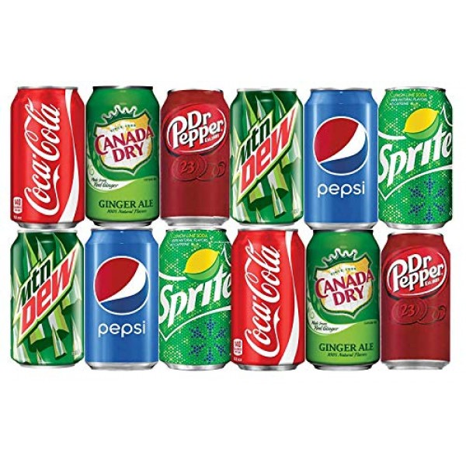
Do’s & Don’ts of Food & Drinks
Avoid foods that are sticky, hard, & full of sugar.
Excess consumption of beverages high in sugar can cause tooth decay.
You can chew gum, just make sure it’s SUGARFREE

Slide 12
Broken Brackets
You are allowed 5 broken brackets
Additional breakage will cost $25 per bracket
Avoid chewing on pens, pencils, fingernails, bottle caps, ice, etc.
Please bring any broken brackets to your next appointment so we can glue them back on.

Slide 13
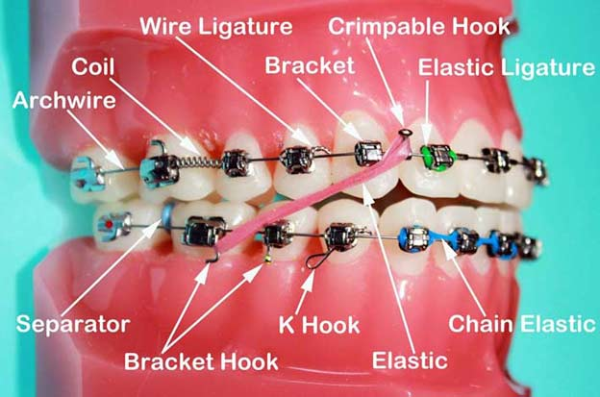
Know your Braces!

Slide 14
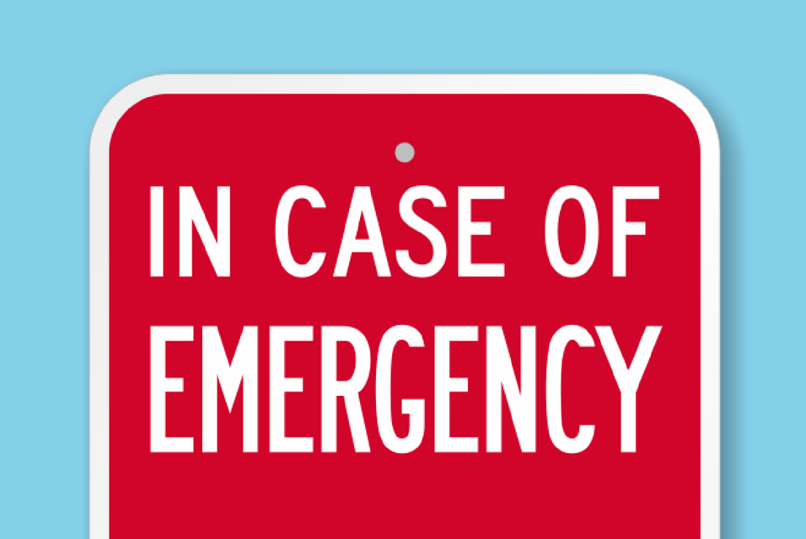
Orthodontic Emergencies
In case of an emergency please contact our on-call assistant at (308) 220-8687
Most problems can be remedied at home.

Slide 15
Don’t forget to schedule regular cleanings and checkups with your general dentist

Slide 16
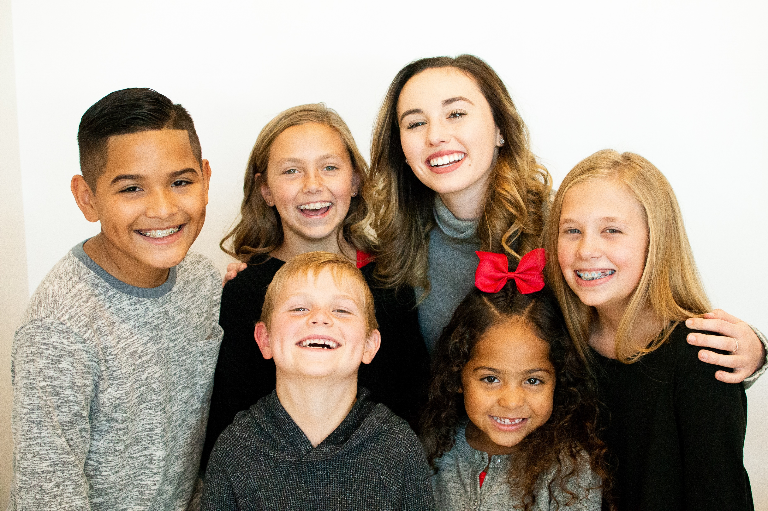
Webb Ortho T-shirt or Baseball Hat?
THANK YOU FOR TRUSTING WEBB ORTHODONTICS TO MAKE YOUR SMILE GREAT ☺

